Slide 1

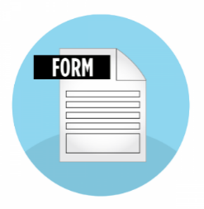











Server will generate encrypted certificate using public key contains all information such as agreement, user identity, signed time, received code + phone/email address, and some additional data like IP address, location
User fill in the form
based on ID card (KTP)
Server will generate a code
1
2
3
The code sent via SMS / Email
5
4
User sign the agreement
using received code
6
Certificate ready to be stored
8
7
To open / view digital signature / certificate must apply a combination of at least 2 (two) factor authentication. (ID, username, password, id, birthdate, etc.) to obtain public key and then decode the certificate
9
Certificate and public key stored in the data storage facility, which using reliable system owned by the E-Signature Operator or the owned Supporting E-Signatures Service (software/system), who can detect any changes.
Any alteration to e-signatures that occurs after the time of the signing must be traceable
Digital signatures / certificate decoded and contains of agreement, user identity, signed time, and
some additional data like IP address, location

